Slide 1

Expansion of Startups in US from 2017-2018: Trend Analysis using small scale data
VISUALIZATION USING POWERBI
Created By Neena Shereen Prathap

Slide 2
Source & Structure
“StartupExpansionData.xlsx”
Information
concentration of startups in different regions in USA
Pre-processing
Marketing Rate of Interest’ = Revenue generated” /“marketing expenditure”.
Kaggle
the income generated by each firm
their marketing expenditure, location.
150 rows and 7 columns with no missing values or predominant outliers.
Marketing ROI measures the revenue generated by per unit marketing expenditure.
Standardized using Z-score.
DATA

Slide 3
Purpose of this analysis
OBJECTIVE
Use analytical functions in PowerBi for EDA
Visualize and document the trends in the data
METHODOLOGY
Data profiling using PowerBi
Advance Excel tools for auto filling the geographic details (latitude and longitude)
IF functions in PowerBi for regional classification
Other analytical tools in PowerBi for calculating hidden variables.

Slide 4
Overview

Slide 5
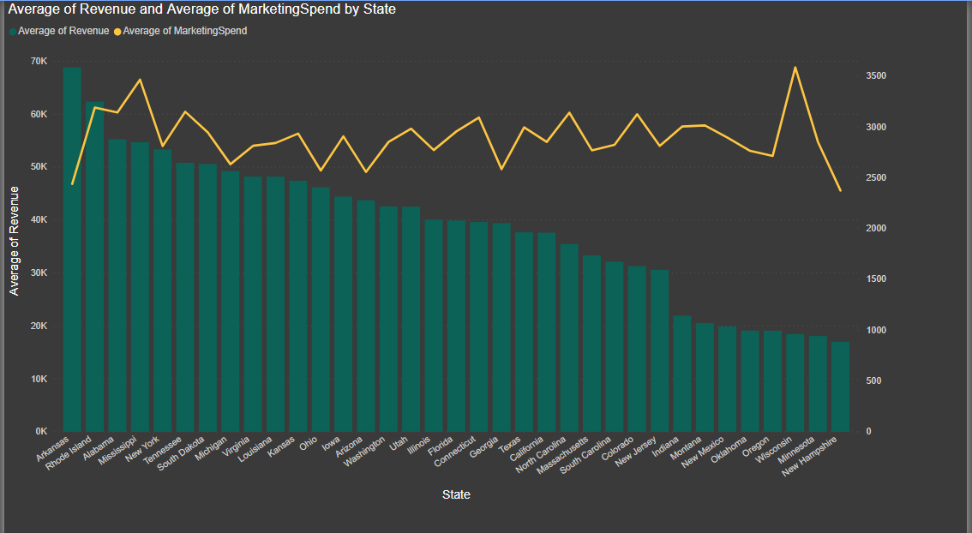
Whole picture of the TREND
Startups in Wisconsin, Utah, Illinois , Florida, New Mexico spend more on marketing without subsequent increment in average annual revenue.

Slide 6
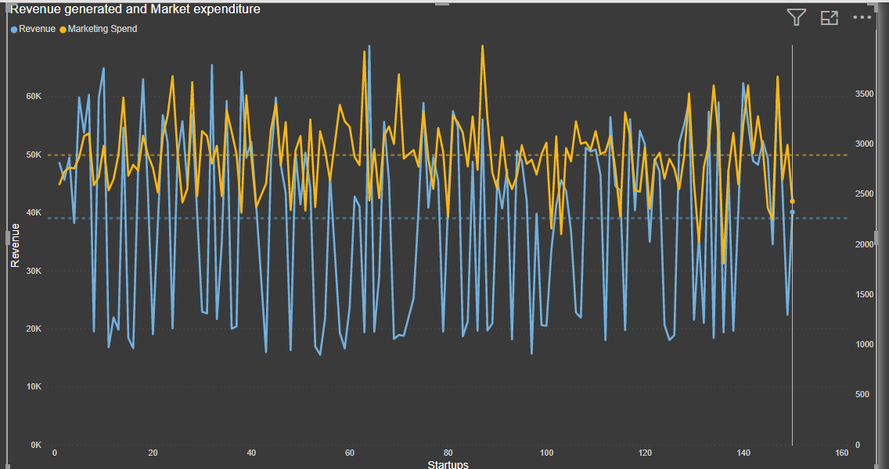
Further Analysis showed….
The Startups in ARKANSAS spend little on marketing , but their average annual revenue is high.
The pattern, with the given data show a week positive correlation between Marketing expenditure and income earned.
But for certain regions, the relationship is inverse.

Slide 7
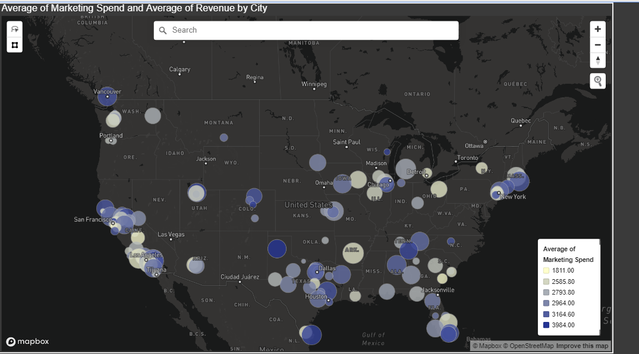
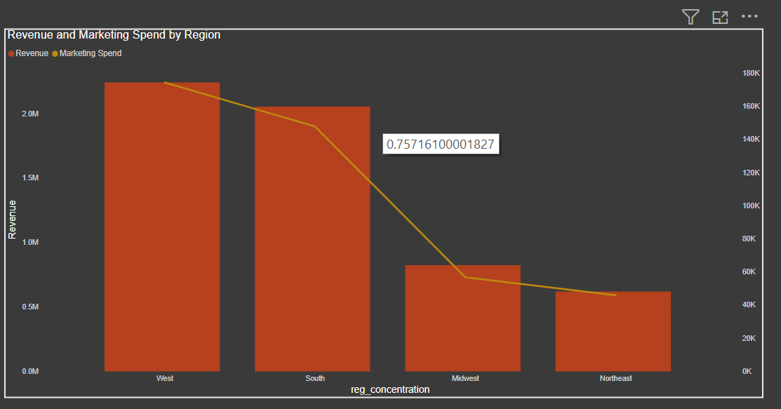
Regional distribution of Revenue and marketing expenditure

Slide 8
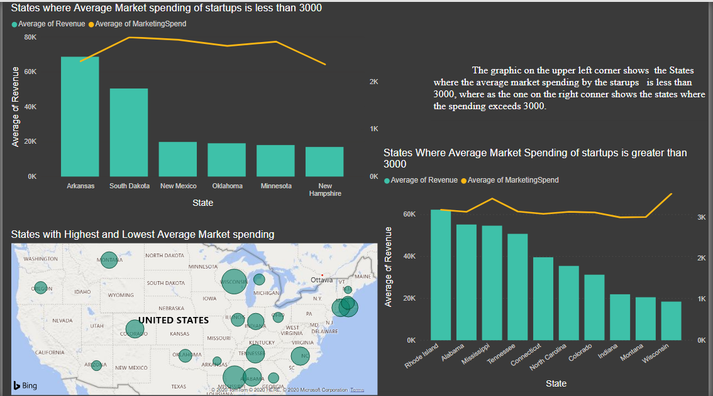
Startups that spend more than 3000k on marketing , tend to earn relatively higher revenue

Slide 9
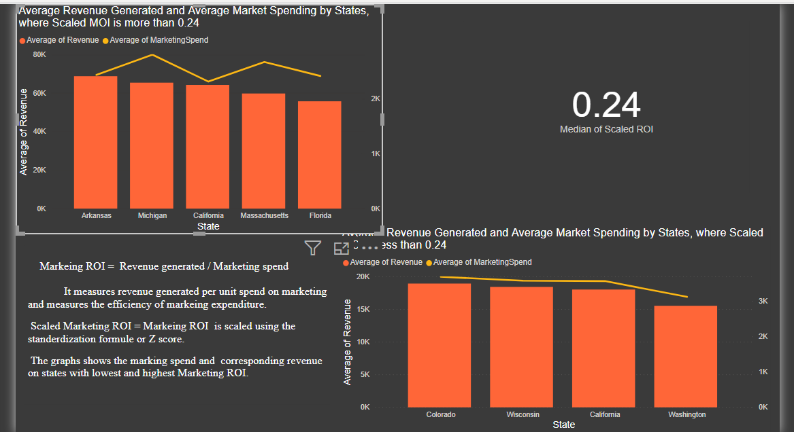
Market roi measures the efficiency of the marketing expenditure.

Slide 10
THANK YOU! Please click on the link below to view the dashboards
startups in USA - Power BI

